Slide 1




PRD §1 Header
FDE SPRINT · HACKATHON MVP · AUGUST 2026
Smart Inbox Triage
From 80+ unread operational messages to a prioritised action list — in minutes.
Version 1.0 · Owner: FDE Group 3 · Status: MVP / hackathon prototype
Team: Kiran Hegde · Amol Mithari · Manasi Suthar · Surinder Dhanjal
Gemini — classify, explain, draft
Supabase — persistent triage store
Google AI Studio — build & deploy

Slide 2
Why — and what success looks like
PRD §2 · §3
The problem
< 2 min
< 10 s
80+ WhatsApp & email messages pile up by 10 AM — breakdowns beside routine confirmations.
≈ 1 hour lost daily just deciding what matters, before any action starts.
Urgency judged inconsistently under load — critical issues risk being missed.
to triage a full batch
AI response per request
≥ 95%
≤ 3 steps
recall on critical messages
from paste to prioritised view
Objective: paste a batch, instantly see what needs attention now, why, what to do — and what to reply.
Outcome: ~1 hour of triage → a few minutes.
Must not break: no silent drops, no invented facts, never auto-send. Uncertain → “Needs Review” — recall over false confidence.

Slide 3

The user, the evidence — and the solution
PRD §4 · §5
Riya — Operations Manager
50-person logistics startup. Coordinates pickups, deliveries, drivers, vehicles and vendors over WhatsApp and email.
The solution — every message returns
Priority
Critical → Needs Review
Category
e.g. vehicle issue, delay
Reason
why it matters, in one line
Evidence :
80+ unread by 10 AM · ~1 hour of manual triage · urgent incidents buried among routine updates.
Action
recommended next step
Draft reply
editable, never auto-sent
Secondary users (later): dispatch, warehouse, fleet, support and vendor-management teams.
Deliberately drop for MVP:
WhatsApp / Gmail APIs · automatic sending · multi-agent orchestration · RAG / vector DB · auth & roles — none needed to validate the core hypothesis.

Slide 4
Product flow — Riya’s journey
PRD §6
1
2
3
4
5
Paste the batch
Validate input
Gemini analyses
Save to Supabase
Prioritised dashboard
Drops today’s WhatsApp / email messages, clicks Analyse
Empty or oversized input is stopped before any AI call
One structured request → priority, reason, action, reply
Every classified message persists as a row
Critical first — read, edit the reply, act
Edge cases handled gracefully
Empty input
blocked with a clear prompt — no AI call
Ambiguous message
flagged “Needs Review”, never invented
Invalid JSON
retry once, then a graceful error
Save failure
results still shown, with a warning
Instrumented for later analytics: triage_started · critical_message_detected · classification_overridden · draft_reply_edited · result_saved

Slide 5
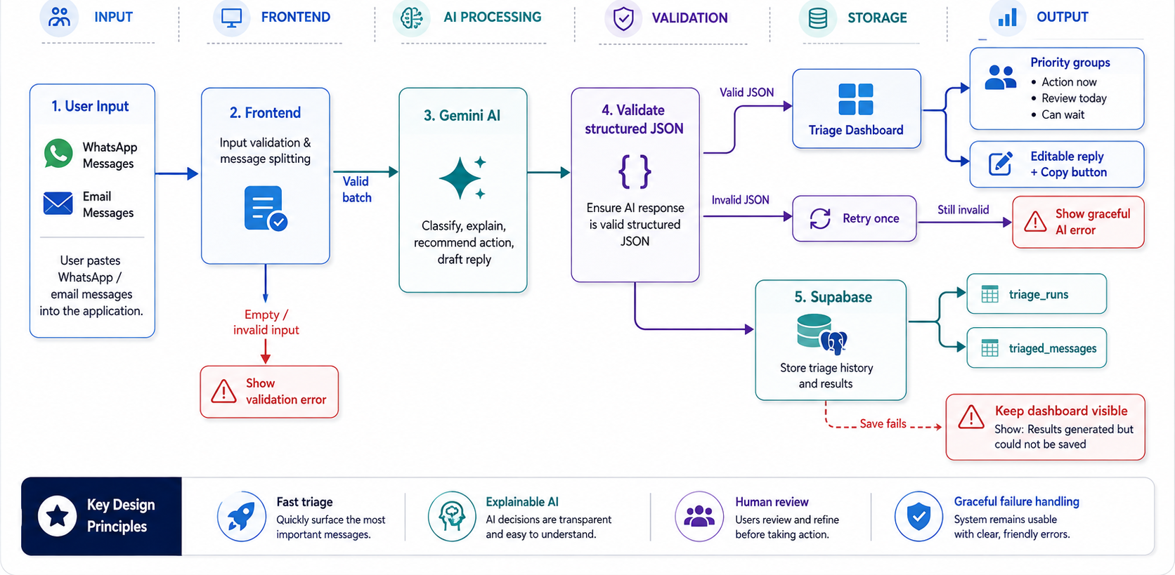
Solution architecture
PRD §6
Gemini via Google AI Studio · Supabase · human-in-the-loop
One structured Gemini call per batch → validated JSON → Supabase → priority dashboard. Every failure path is graceful; nothing is sent without human review.

Slide 6



Timelines, dependencies & documents
PRD §7 · §8 · §9
60-minute build
Dependencies & risks
Related documents
0–10’ Discovery
10–15’ Architecture & schema
15–35’ Core AI + UI build
35–45’ Supabase integration
45–50’ Testing & edge cases
50–55’ Deploy — Google AI Studio
55–60’ Demo preparation
Gemini — classification, reasoning, drafting
Supabase — structured persistence
GitHub — version control
Google AI Studio — build & deployment
PRD v1.0
AI system prompt
Supabase schema + test dataset
Top risk: critical → routine misclassification. Mitigated by “Needs Review” + human validation, keys in environment variables, deploy early.

Slide 7





Future enhancements
What we build after the MVP proves the core loop
Live channel integration
Assisted replies
Team workflows
Ingest WhatsApp & Gmail directly — no copy-paste
One-click send, always after human approval
Roles, assignment and escalation across ops teams
Ops knowledge (RAG)
Learning loop
Ops analytics
Ground replies in SOPs, contracts and vendor history
Improve from overridden priorities and edited replies
SLA trends, incident hotspots and vendor scorecards
Same principle throughout: AI reduces the noise — the operations manager stays in command.

Slide 8
THE WHOLE THING AT A GLANCE
All nine PRD sections — covered in this deck
1
Slide 1
2
Slide 2
3
Slide 2
HEADER — Ownership
WHY / OBJECTIVE — Problem
SUCCESS METRICS — Guardrails
4
Slide 3
5
Slide 3
6
Slides 4–5
WHO ARE THE USERS — Riya
SOLUTION — Triage
PRODUCT FLOW — Journey
7
Slide 6
8
Slide 6
9
Slide 6
TIMELINES — Commitment
DEPENDENCIES — Risks
RELATED DOCUMENTS — Evidence
One PRD, nine sections, five minutes — nothing skipped, everything scoped.

Slide 9
1
PRD https://github.com/sdaistudio/xploreai-site/blob/main/1.%20PRD.docx
2
PPT
https://github.com/sdaistudio/xploreai-site/blob/main/2.%20Smart_Inbox_Triage_Hackathon_Presentation.pptx
3
Github Link
https://github.com/sdaistudio/xploreai-site
4
Access MVP through Google Studio :
https://smart-inbox-triage.ai.studio/
Access MVP through Vercel :
https://triage-kappa-one.vercel.app/
OR

Slide 10
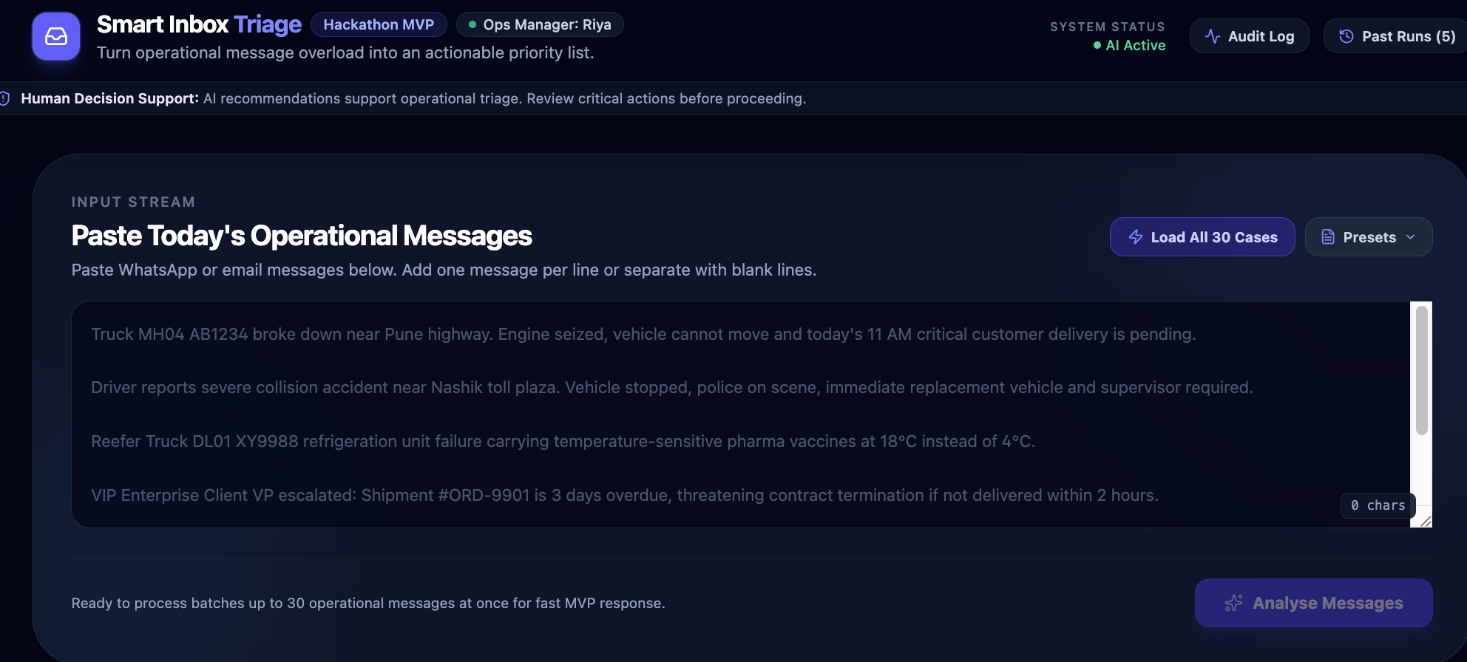
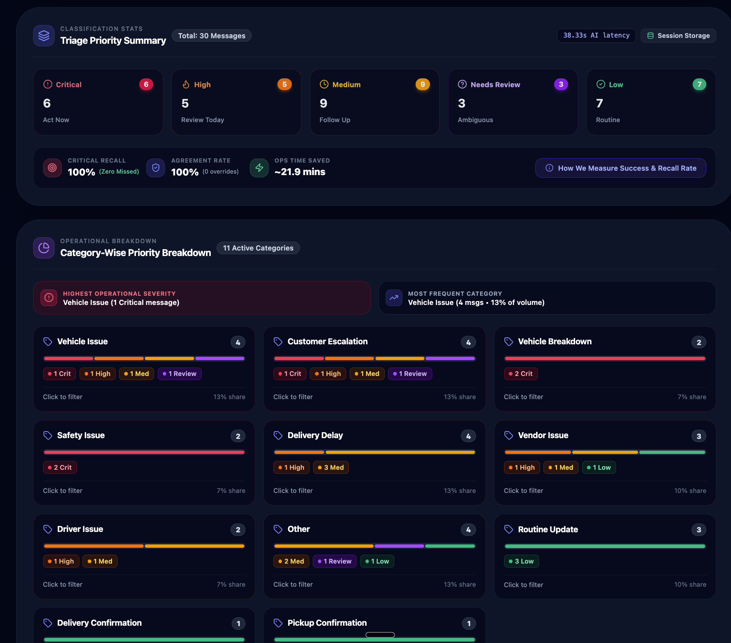
Access through Google Studio :
https://smart-inbox-triage.ai.studio/
Access through Vercel :
https://triage-khral34zx-sdaistudios-projects.vercel.app/
OR
1. Paste Today’s messages / mails
And press “Analyse Messages”
2. Get Priority & Category wise dashboard
Priority
Critical → Needs Review
Category
e.g. vehicle issue, delay

Slide 11
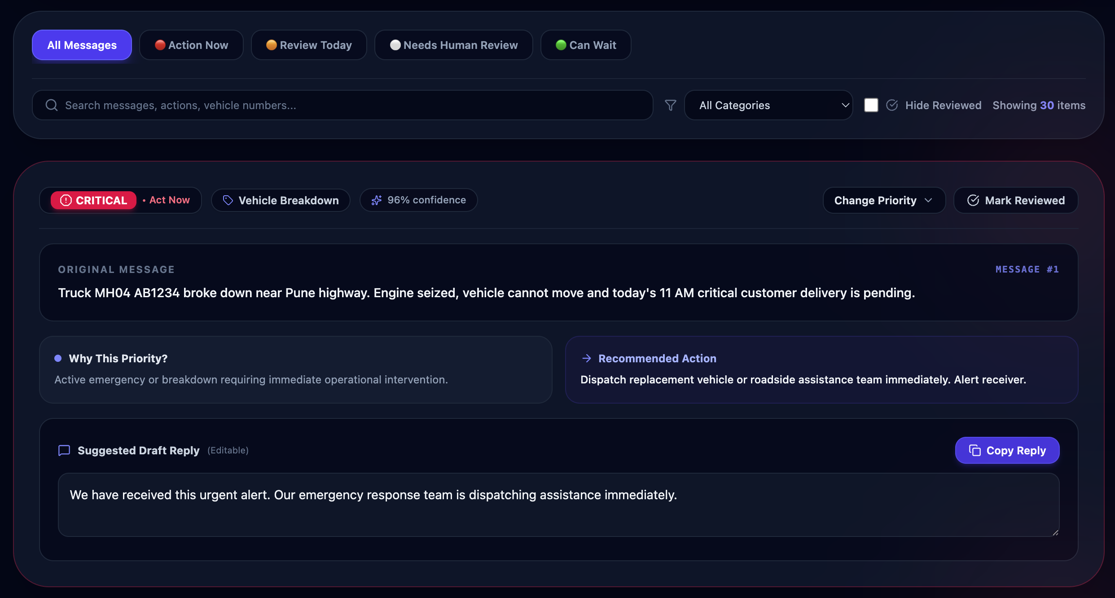
1. Access based on prioritization
Original message
Recommended Action
Why Priority
Suggested Draft Reply

